Slide 1
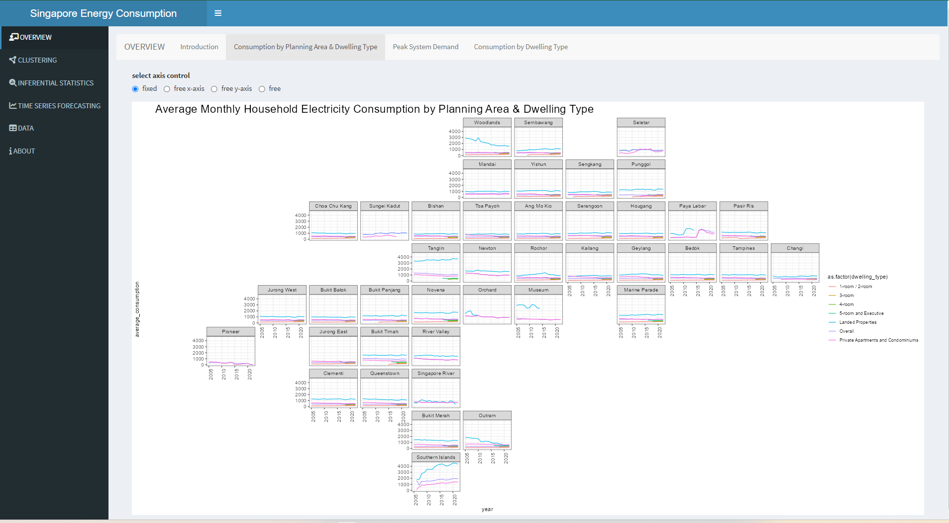

Slide 2
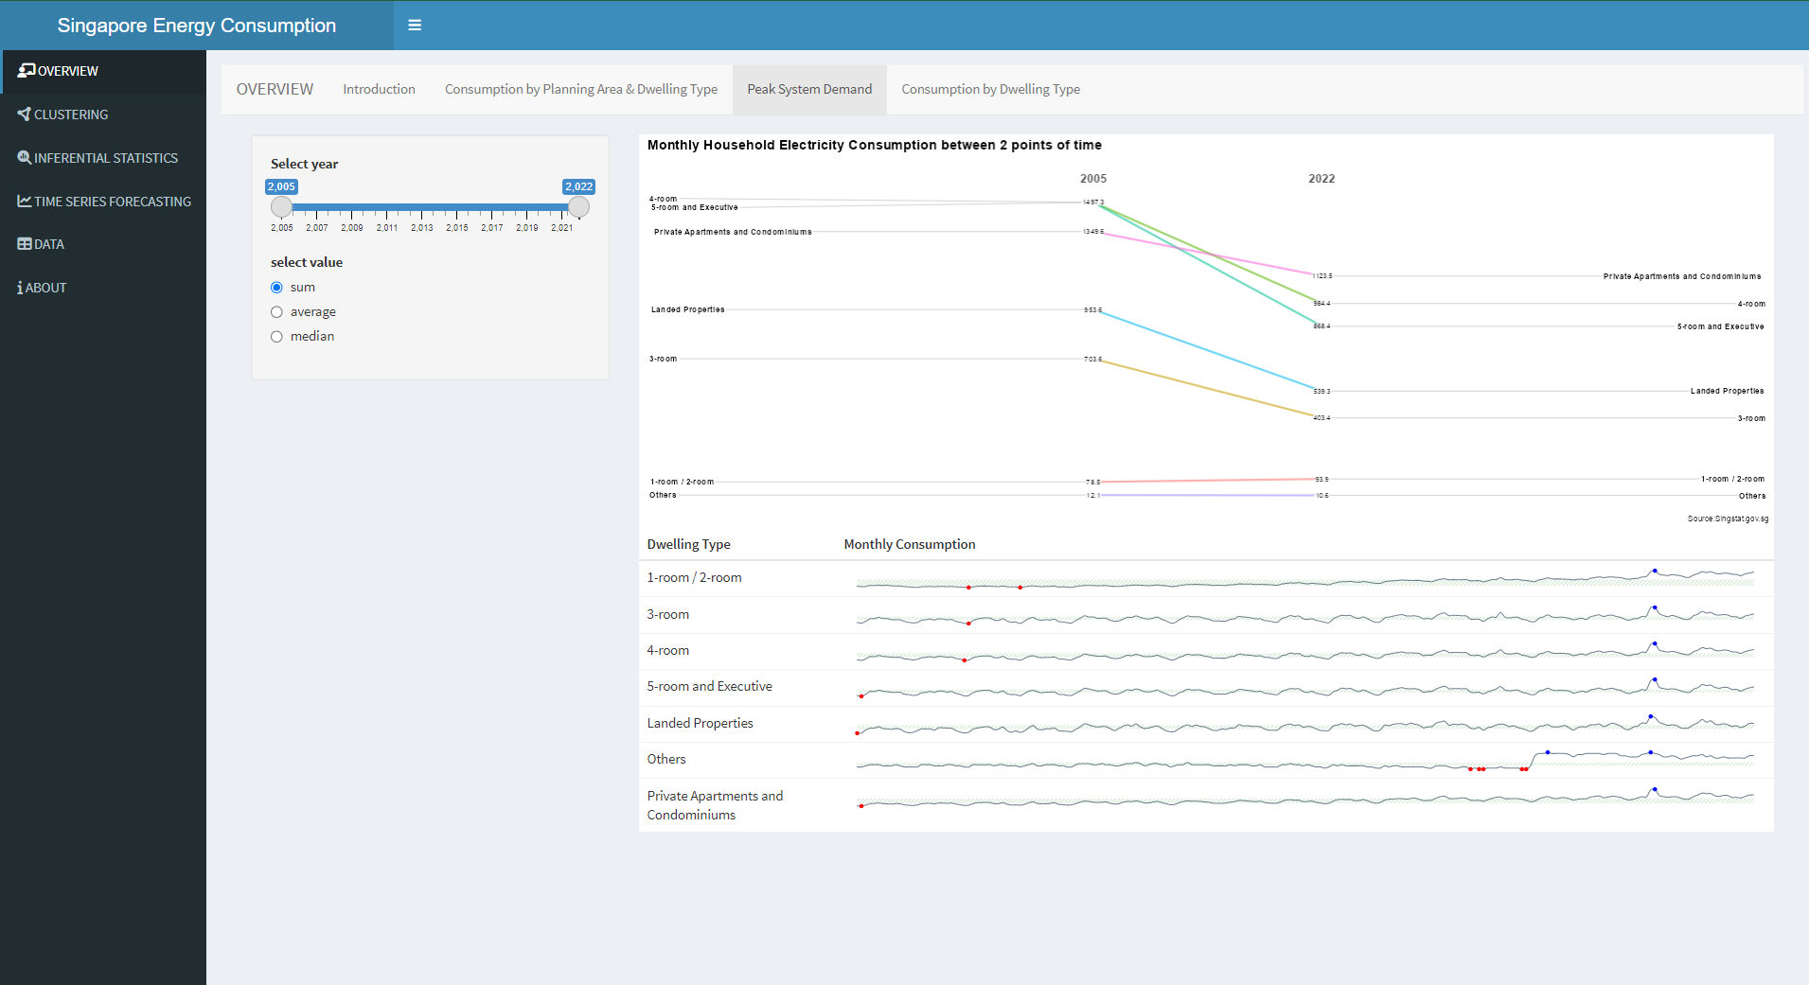

Slide 3
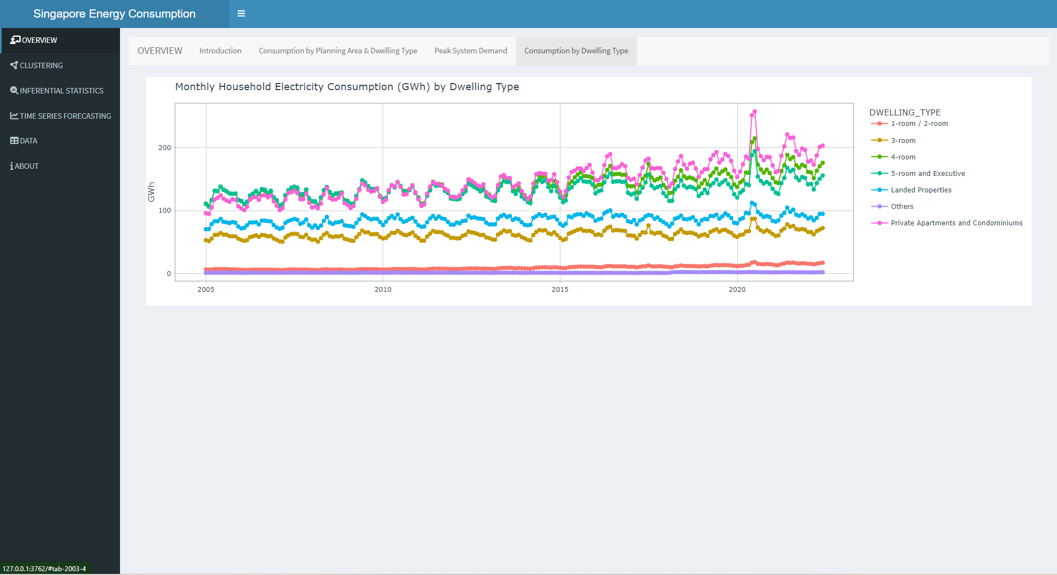

Slide 4
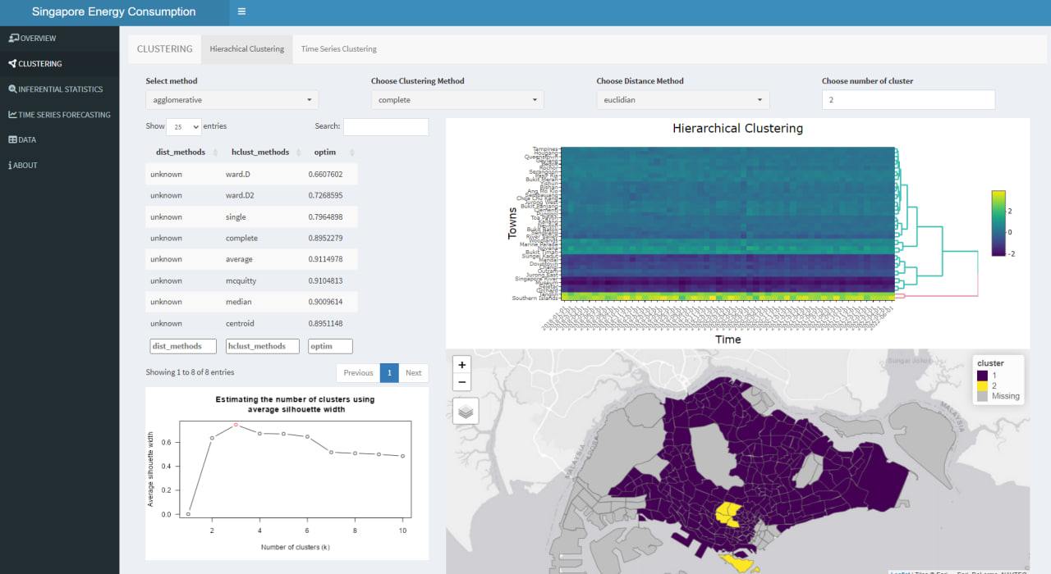

Slide 5
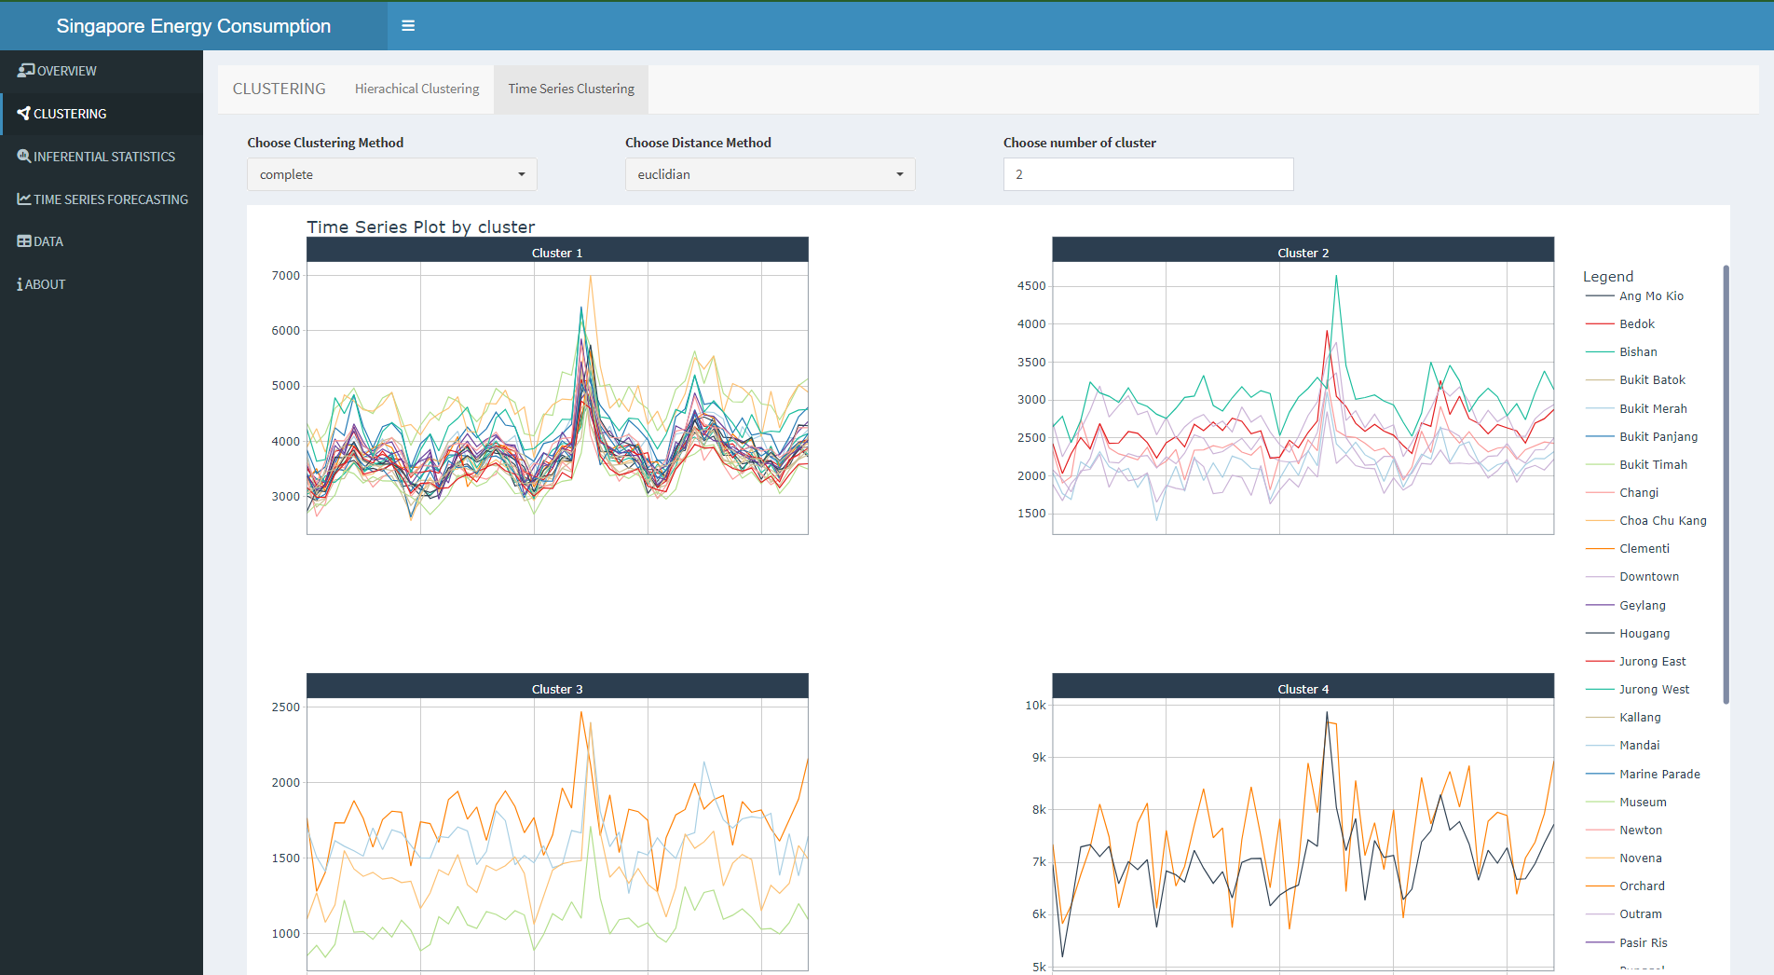

Slide 6
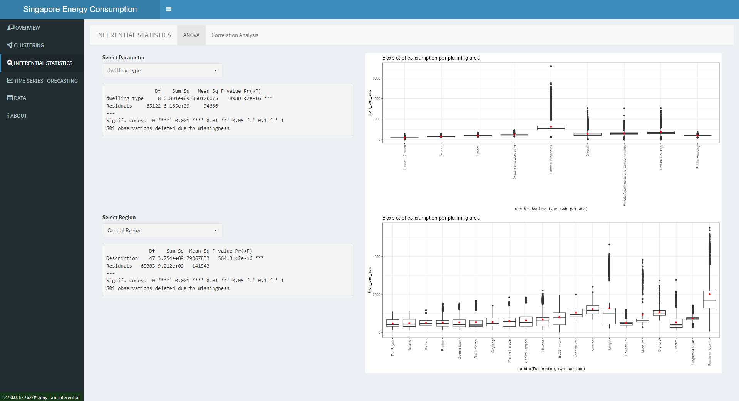

Slide 7
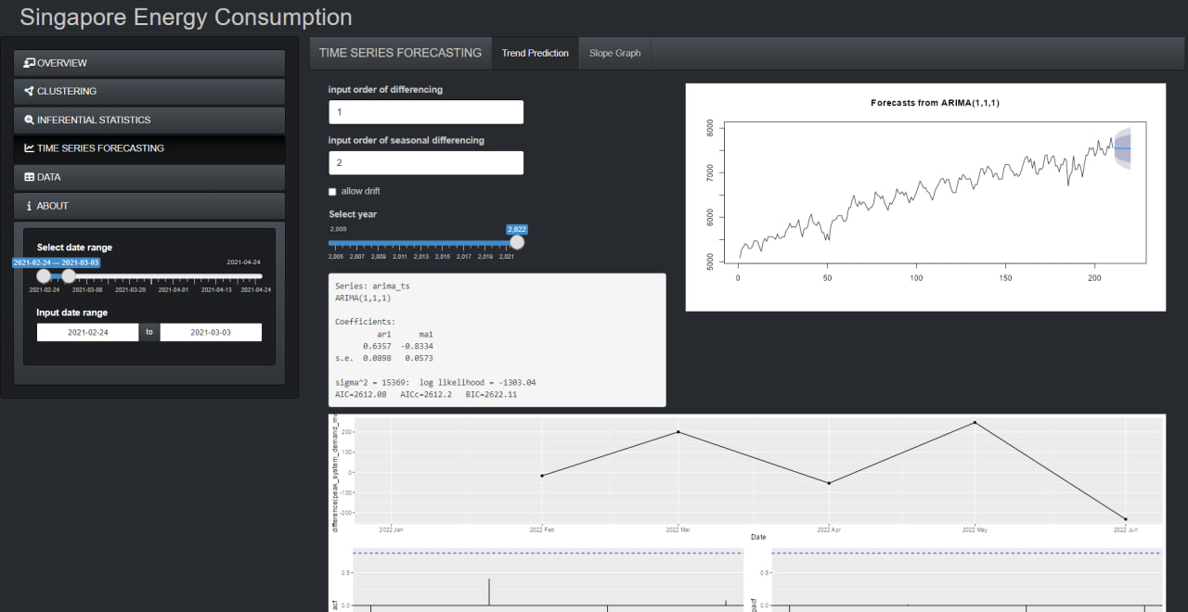

Slide 8
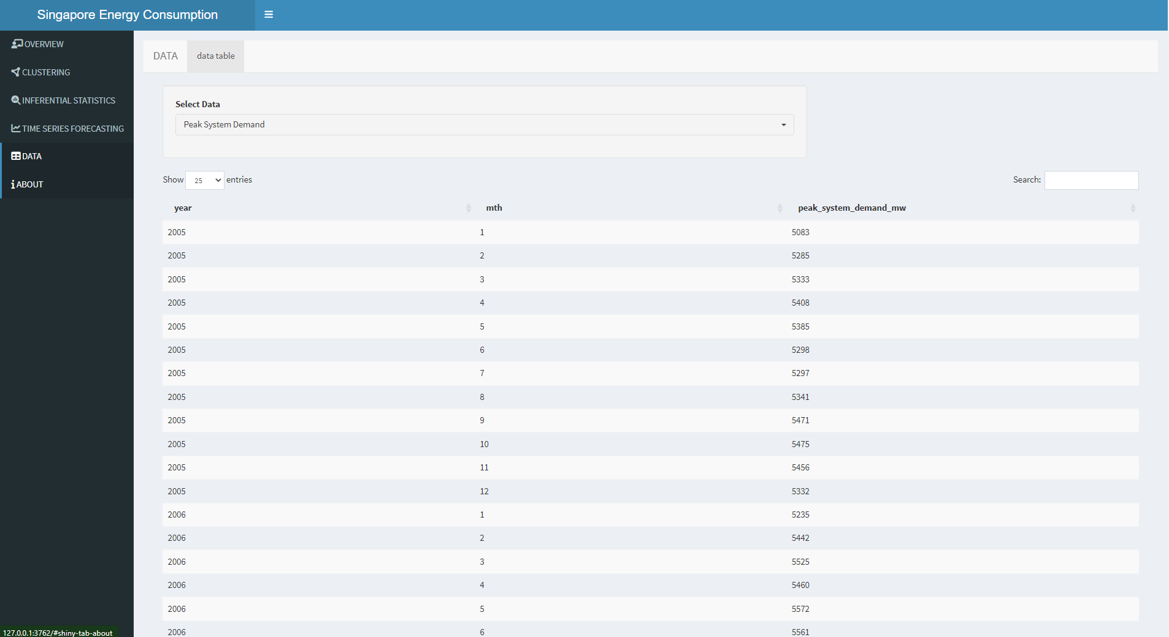

Slide 9
Proposal Requirements
Supply, consumption, prices, renewable energy
Dataset used
Data visualization sketch
Analysis we plan to do (inferential, clustering, forecasting)
packages we plan to use:
Data processing: tidyverse, readxl
Clustering: dtwclust, tsclust
Time series forecasting: modeltime
Visualization: ggplot2, geofacet, gghorizon, tmap, timetk, ggstatsplot
Interactivity: plotly, ggiraph

Slide 10
Overview
Clustering
Inferential Statistics
Time Series Forecasting
Data
An overview tab to include some of the points:
Title, description and objectives of this app
Overall trends for basic understanding:
Basic EDA
Trend of household consumption + tariff (in the same line chart?)
A map showing the consumption with color gradient
Something else…
Notes:
Add EDA together with the introduction description in this page

Slide 11
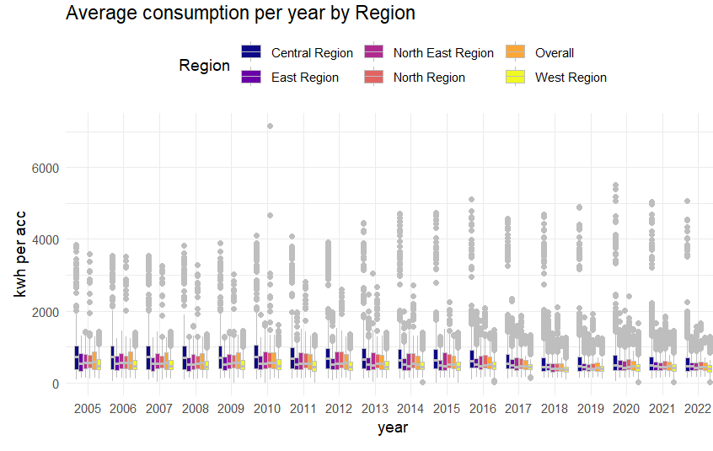
Overview
Clustering
Inferential Statistics
Time Series Forecasting
Data
Average consumption per year by Region
Select Year:
Select Region
Central Region
NorthEast Region
East Region
North Region
West Region
Overall
Users can select Year and Region

Slide 12
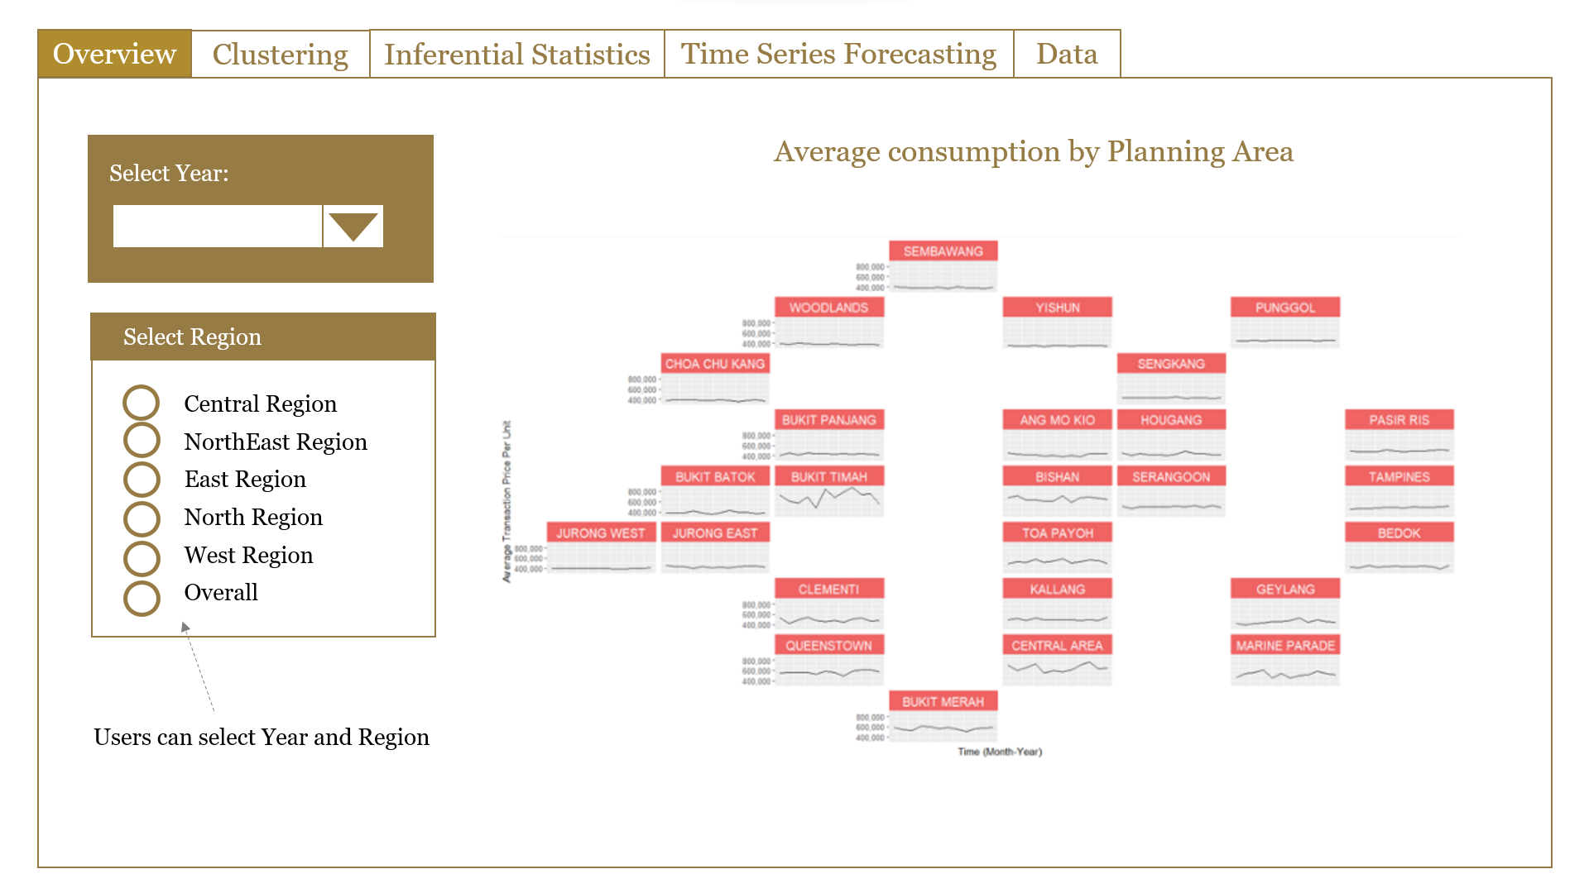
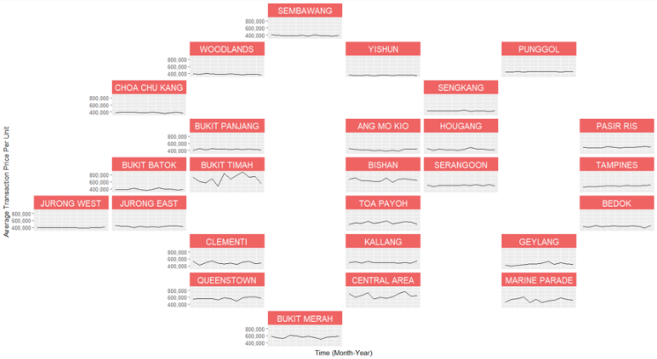
Overview
Clustering
Inferential Statistics
Time Series Forecasting
Data
Average consumption by Planning Area
Select Year:
Select Region
Central Region
NorthEast Region
East Region
North Region
West Region
Overall
Users can select Year and Region
Notes:
https://xang1234.github.io/pyramidgeofacet/

Slide 13
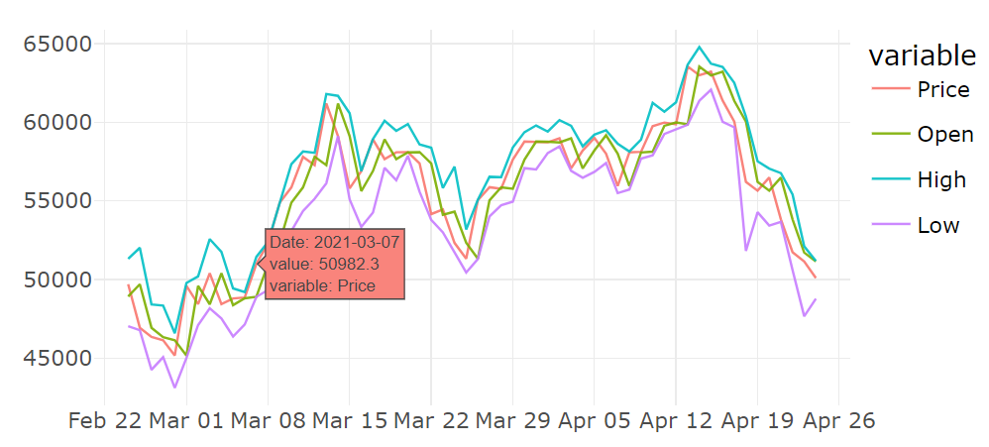
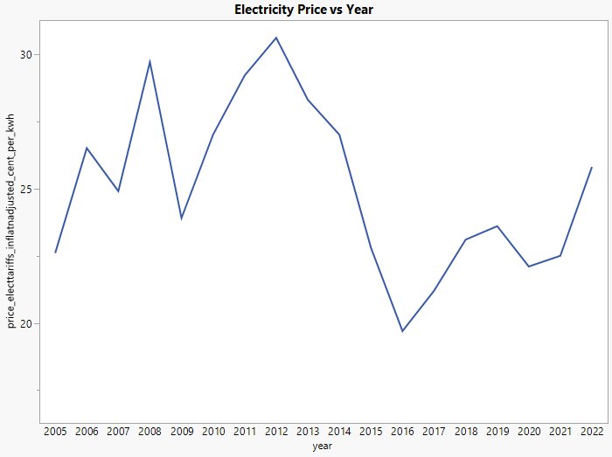
Overview
Clustering
Inferential Statistics
Time Series Forecasting
Data
Price, Consumption, Supply trend over time
Variable
Price
Consumption
Supply
Select date range
Input date range
10-07-2022
to
10-08-2022
Select Variables
Allow users to select date range
Price
Consumption
Supply
Multiselect for user select parameters to include in graph

Slide 14
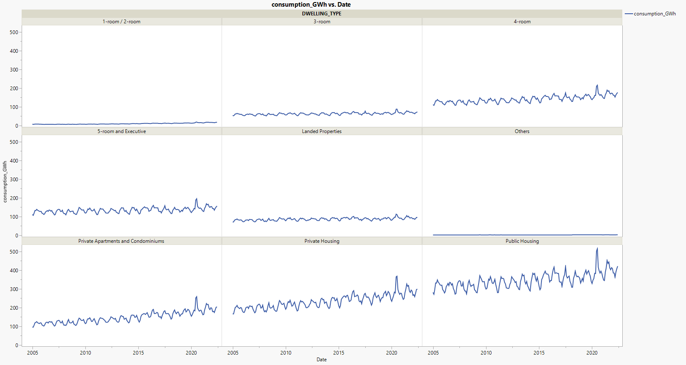
Overview
Clustering
Inferential Statistics
Time Series Forecasting
Data
Electricity Consumption over time for each Dwelling Type
Select date range
Input date range
10-07-2022
to
10-08-2022
Select Variables
Price
Electricity Consumption
Gas Consumption
Supply

Slide 15
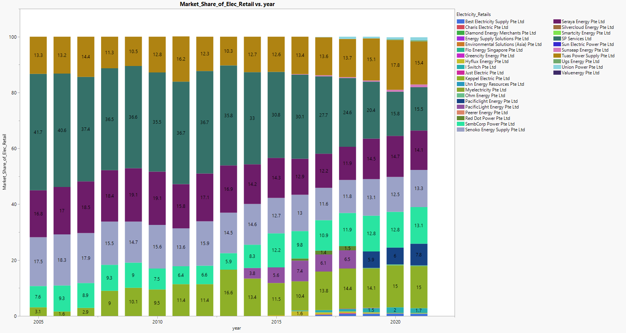
Overview
Clustering
Inferential Statistics
Time Series Forecasting
Data
Electricity Retailer Market Share vs Date
Market share of
Electricity
Electricity Generation
Natural Gas
Allow users to select the parameter

Slide 16
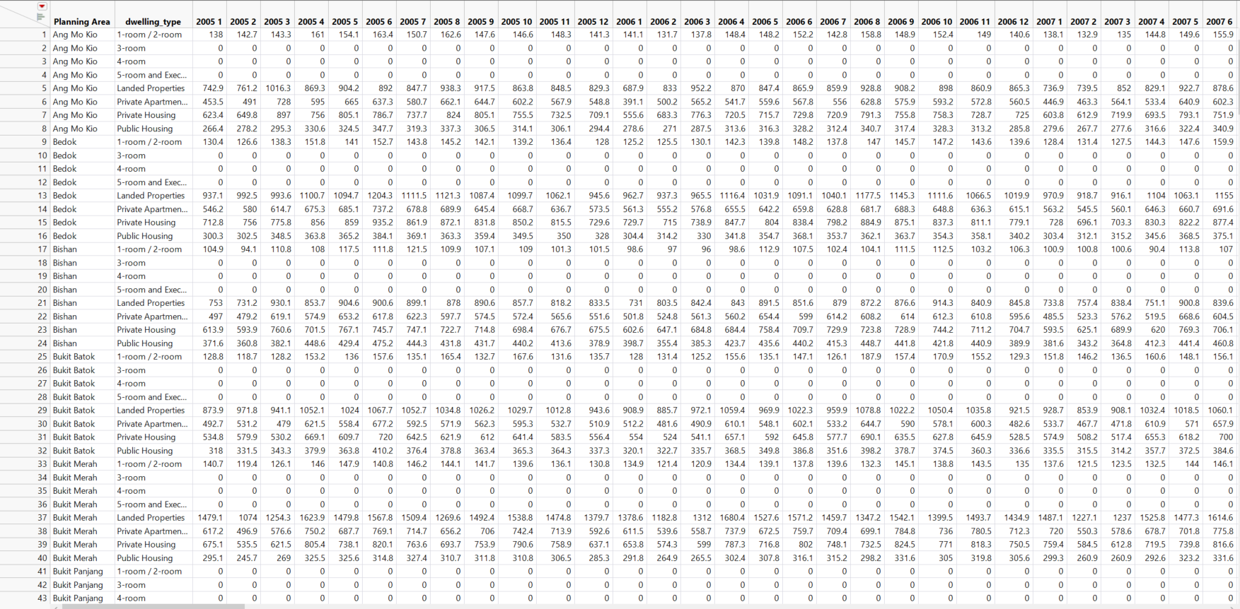
Overview
Clustering
Inferential Statistics
Time Series Forecasting
Data
Transformed dataset (fyi only, not going to be on Rshiny app) – consumption
Notes:
https://medium.com/@panda061325/stock-clustering-with-time-series-clustering-in-r-63fe1fabe1b6
take
DTWclust
TSclust

Slide 17
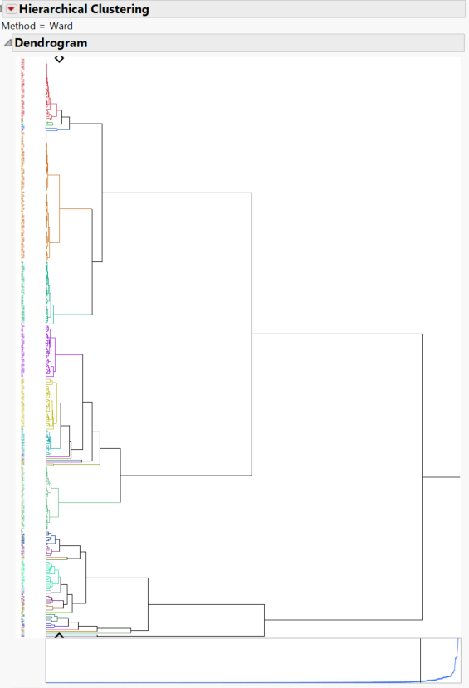
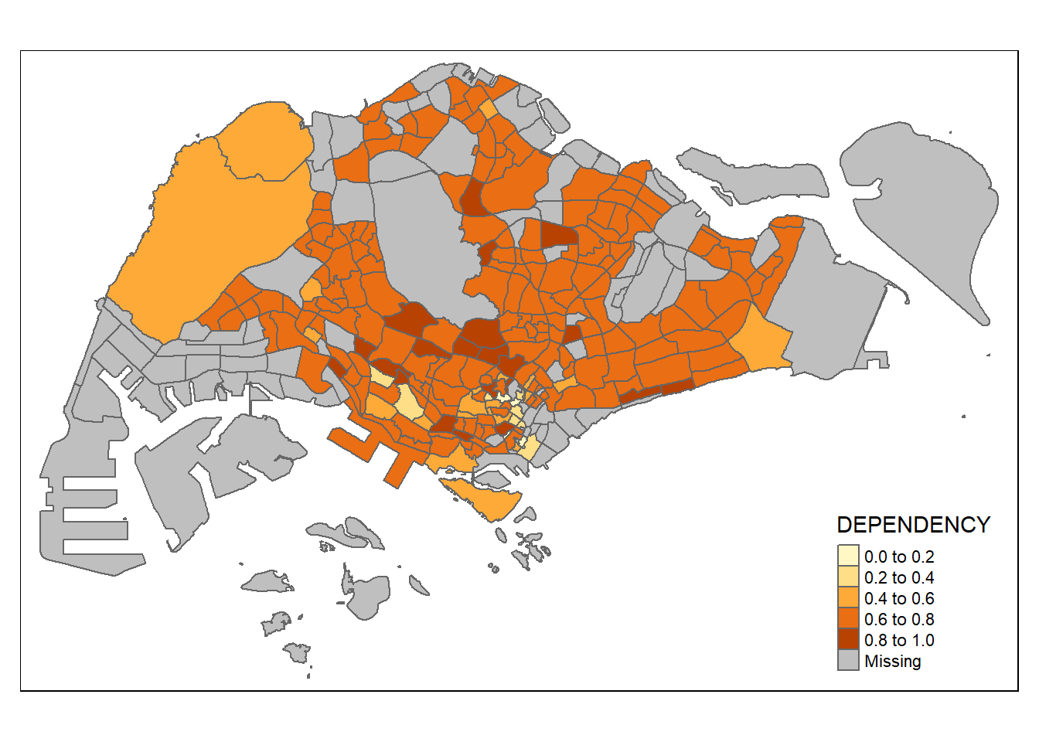
Overview
Clustering
Inferential Statistics
Time Series Forecasting
Data
Choropleth map of Clusters
Hierarchical Method
Ward
Average
Centroid
Single
Complete
Fast Ward
Number of clusters
User can select hierarchical method and number of clusters
Represent cluster on map
Dendogram with color-coded cluster
Notes:
Geofacet
Tmap to plot cluster
https://r-graph-gallery.com/183-choropleth-map-with-leaflet.html

Slide 18
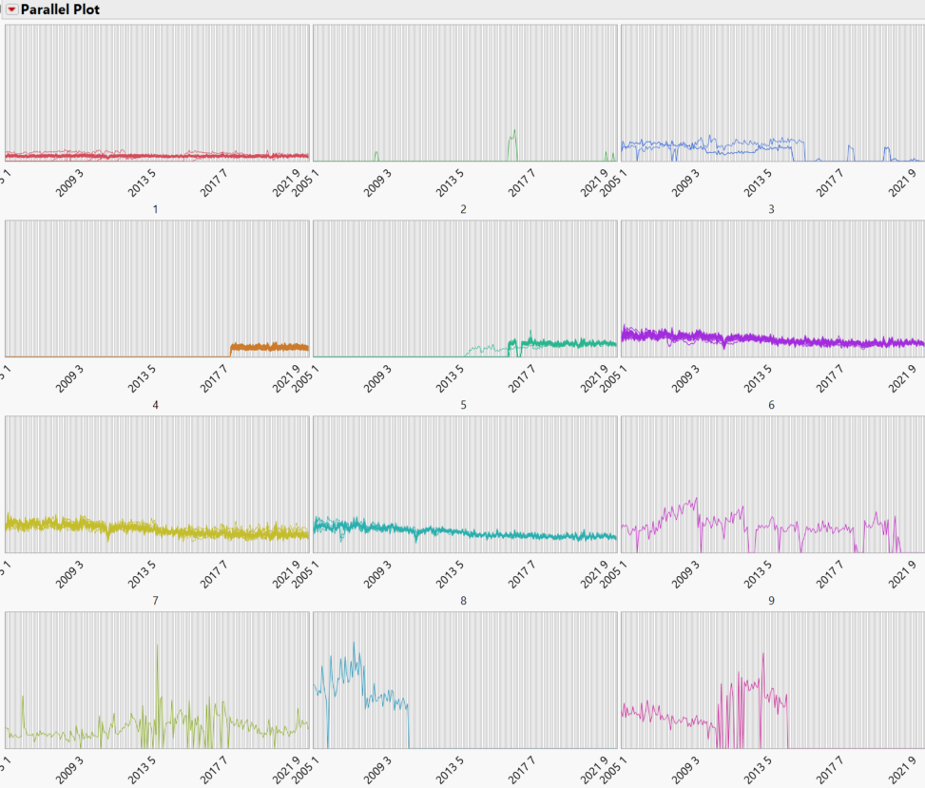
Overview
Clustering
Inferential Statistics
Time Series Forecasting
Data
Year & Month
Notes:
Lesson outline R packages for time series
Timetk

Slide 19
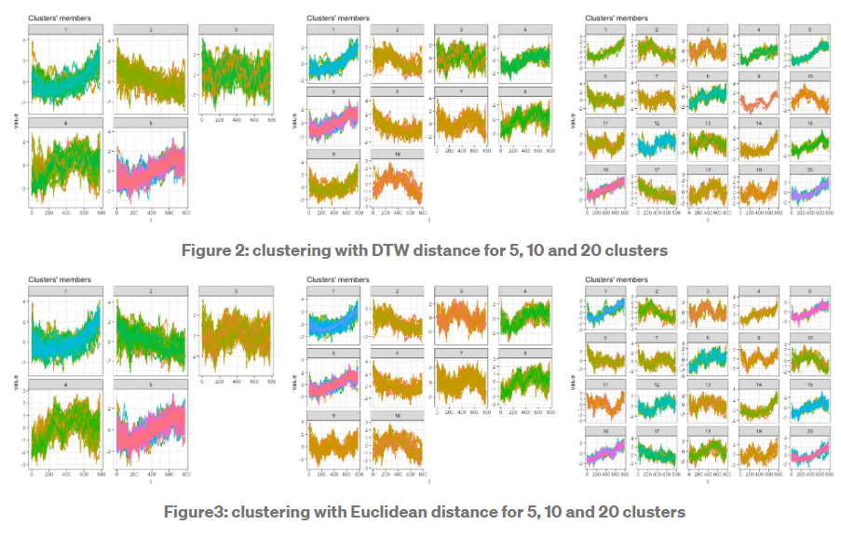
Overview
Clustering
Inferential Statistics
Time Series Forecasting
Data
Notes:
https://medium.com/@panda061325/stock-clustering-with-time-series-clustering-in-r-63fe1fabe1b6
timetk

Slide 20
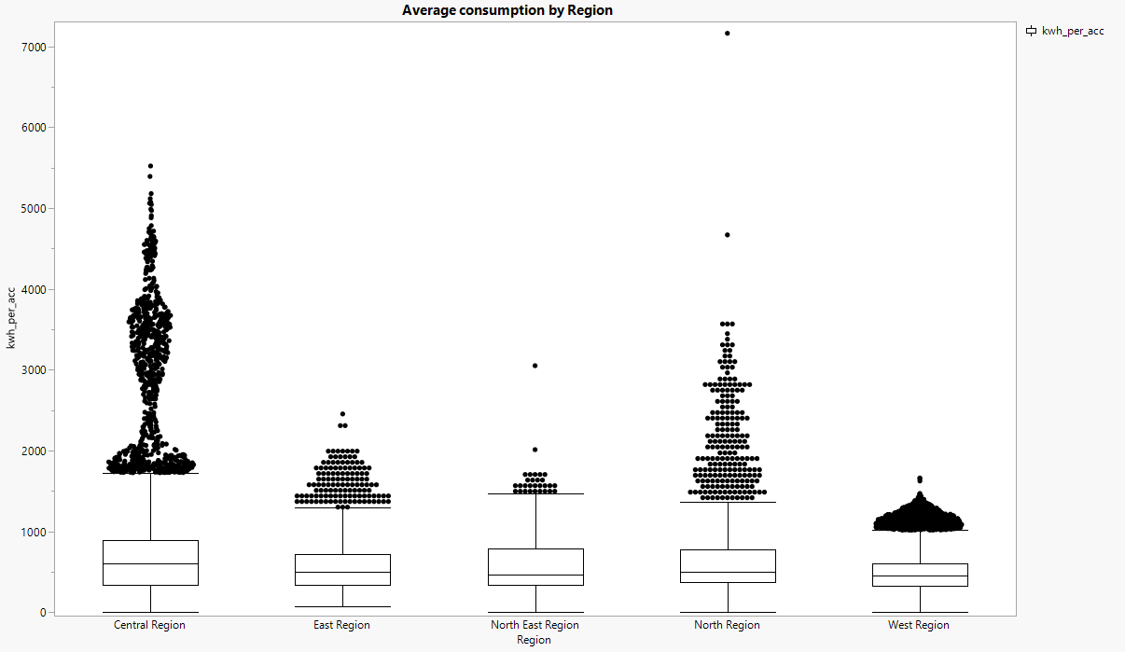
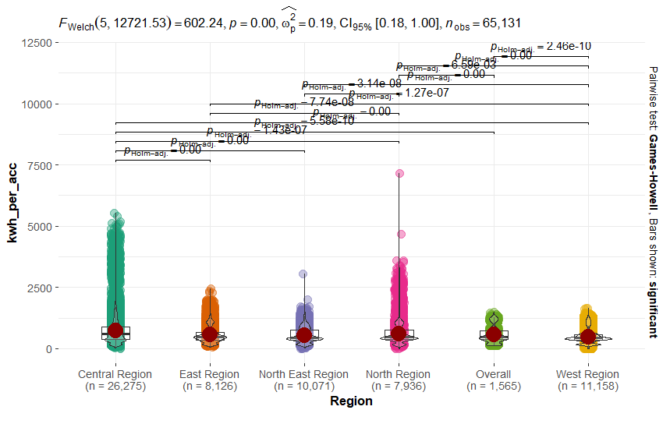
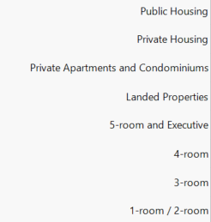
Overview
Clustering
Inferential Statistics
Time Series Forecasting
Data
ANOVA
Select variable
Significance level (alpha):
Electricity consumption
Oil consumption
Gas consumption
Energy consumption
Select dependent variable:
Dwelling Types
Months
Regions
Sectors
Sub-sectors
Planning area

Slide 21
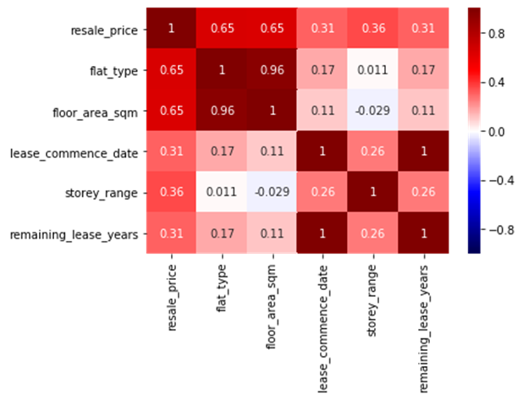
Overview
Clustering
Inferential Statistics
Time Series Forecasting
Data
Correlation Analysis
Select Dataset
Electricity consumption
Oil consumption
Gas consumption
Energy consumption

Slide 22
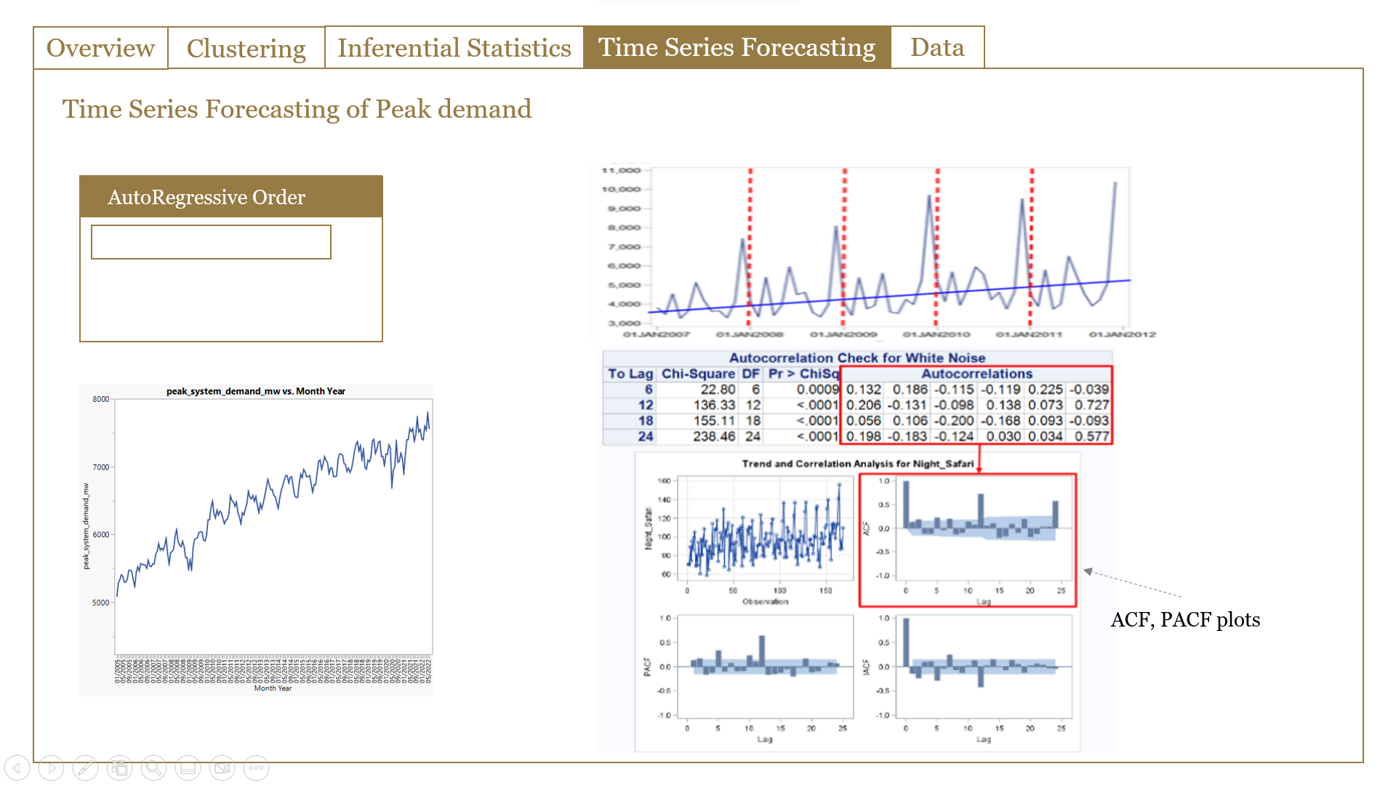
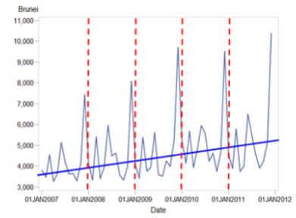
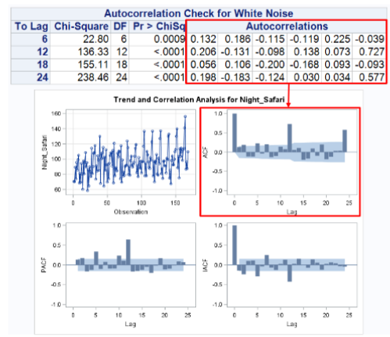
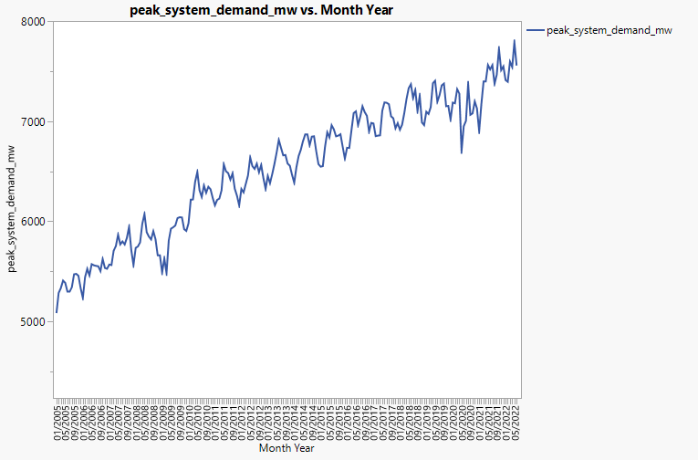
CHOROPLETH MAP
Overview
Clustering
Inferential Statistics
Time Series Forecasting
Data
Time Series Forecasting of Peak demand
AutoRegressive Order
ACF, PACF plots
Notes:
Modeltime -> forecasting

Slide 23
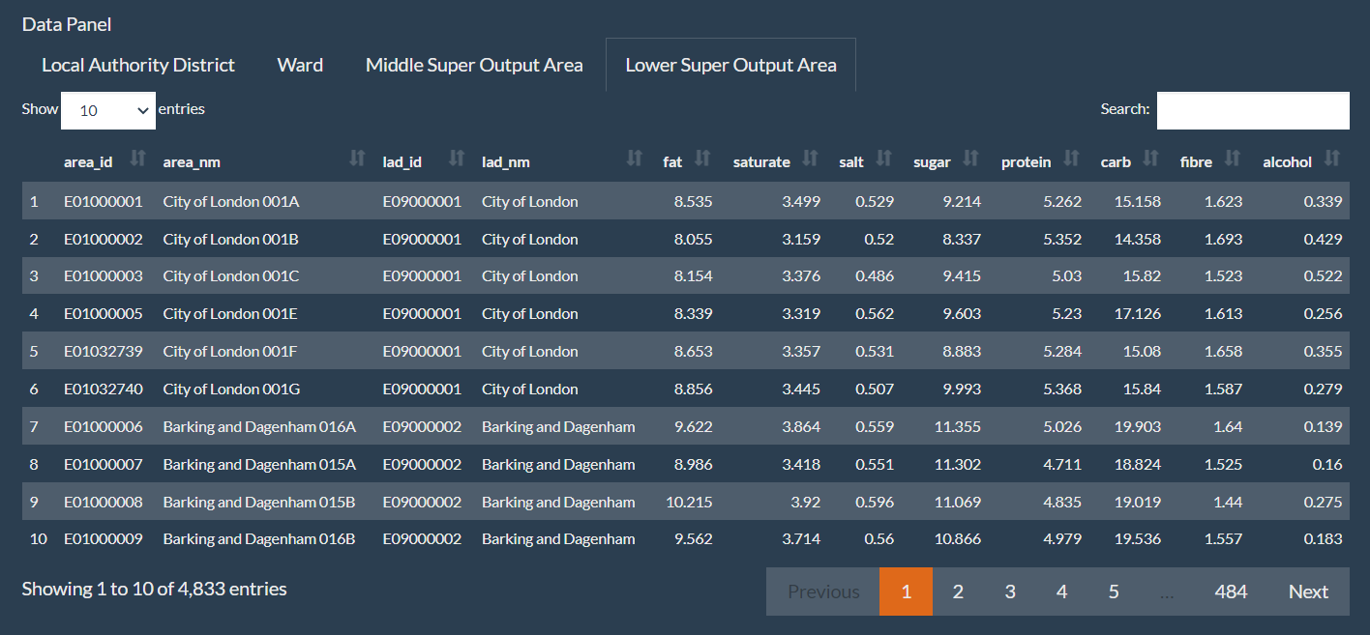
CHOROPLETH MAP
Overview
Clustering
Inferential Statistics
Time Series Forecasting
Data
Show columns
Columns
Multi-select

Slide 24
Back-up

Slide 25
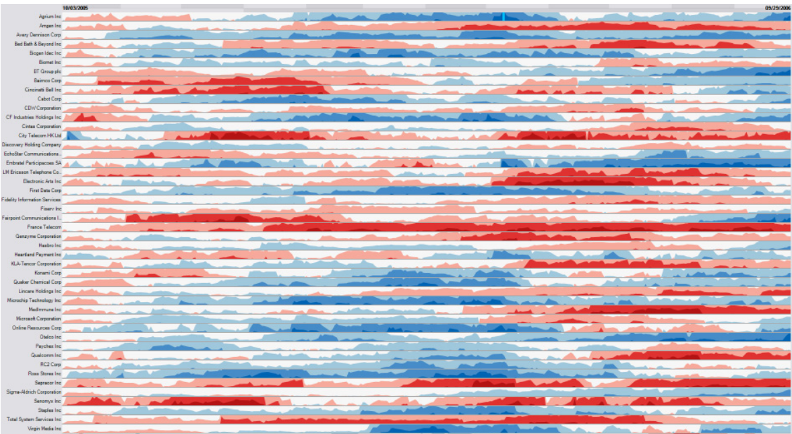
Notes:
Time horizon
gghorizon

Slide 26
References
https://www.jienamclellan.com/post/shiny/
https://earth.org/singapore-energy-transition/
https://ink.library.smu.edu.sg/cgi/viewcontent.cgi?article=5379&context=sis_research
https://r.tquant.eu/tquant/Tartu/Frequentist_vs_Bayes_post_hoc/

Slide 27
Brainstorm
1) visualise time series of data consumption, then do time clustering
2) we can also predict electricity demand for planning purpose
3) we can also combine this dataset with population to see how different demographics can affect consumption, then we can better predict maybe?
4) cluster by area and plot in map. user can input cluster technique or #of cluster
5) With the grid emission factor, project what’s the pollution contributed from power generation (could pollution be controlled by electricity prices?)
6) saw manpower data. Study the demographics of employees. Do the electricity market expects a manpower crunch in the near future? Is automation the way to go?
7) some inferential analysis to consider: tariff and consumption correlation, test any significant difference in consumption between different type of dwelling or planning area.
8) time series analysis - stationary, seasonality, ARIMA etc
9) Power balance - simple visualisation/calculation - understanding the power gap and major power consumers based on power balance
10) Inferential analysis e.g. ANOVA on the consumption by area -> Difference in mean of consumption across planning area
Notes:
To visualize/analyze time series data

Slide 28
Other Considerations (Back-up)
Based on machine learning tools, using the following data predict what is the best investment govt should make to meet the future peak demand:
Future peak demand: can be an input field by user based on their expected number
Predictor variables: technology type & capacity (T2.5), company & technology type (T2.5.1) company share (T2.6)

Slide 29
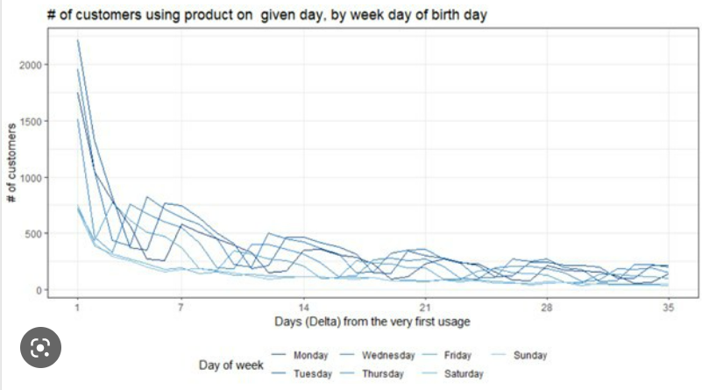
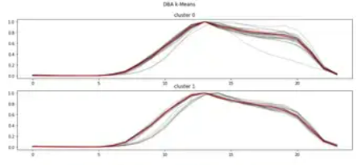
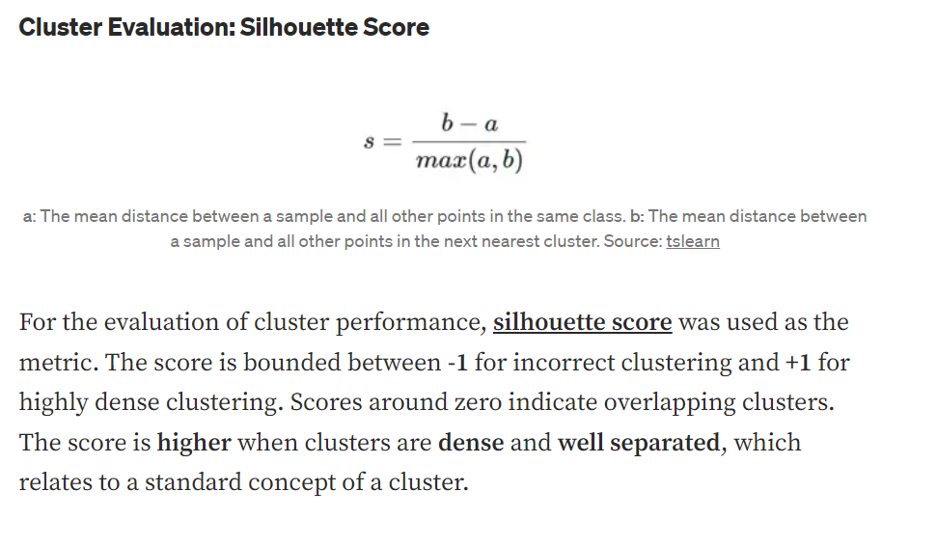
Time Series Clustering
Time Series forecasting
Spatial Clustering
Inferential statistics
Time Series Clustering of Electricity consumption
Overall trend of household consumption
Add
Select cluster techniques
Temporal Clustering
Cluster score : 0.268
A Silhouette score to show how well the cluster separate. Scores around zero indicate overlapping clusters. The score is higher when clusters are dense and well separated.
Graph of consumption rate according to time (x: Timeline, y: Consumption)
Notes:
https://towardsdatascience.com/time-series-clustering-deriving-trends-and-archetypes-from-sequential-data-bb87783312b4

Slide 30
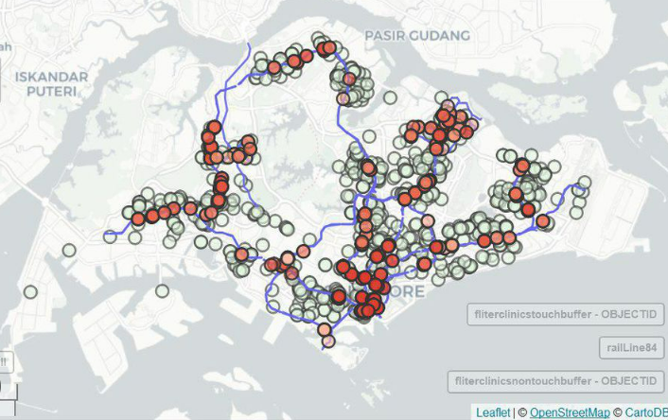
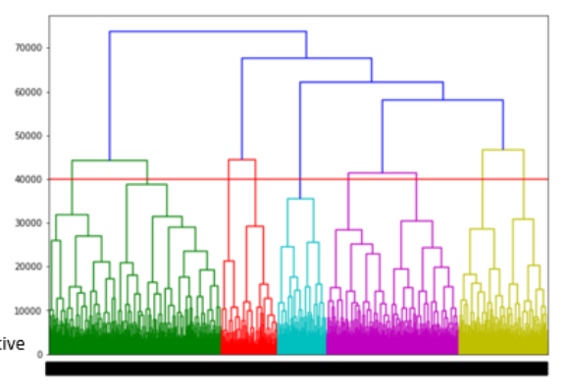
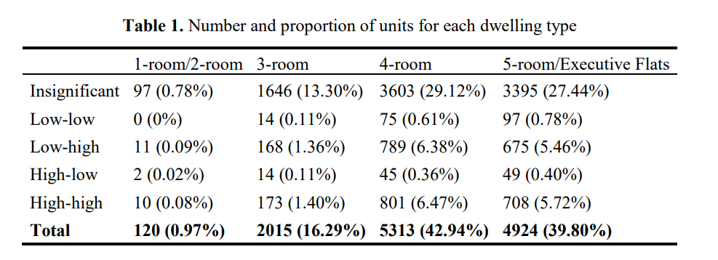
Time Series Clustering
Time Series Forecasting
Clustering by area
Inferential statistics
Cluster of consumption pattern by area
Map color the planning area according to the cluster
Select cluster techniques
K-Mean
Hierachical
LDA
Table showing the number of proportion
Show parameter tuning pop-up according to the selection
K-Mean Parameter tuning
K =
Distance measurement
Drop-down list of measurement techniques
Bar that allow user to drag up and down
Notes:
https://ink.library.smu.edu.sg/cgi/viewcontent.cgi?article=5379&context=sis_research

Slide 31
Peak System Demand vs Date

Slide 32
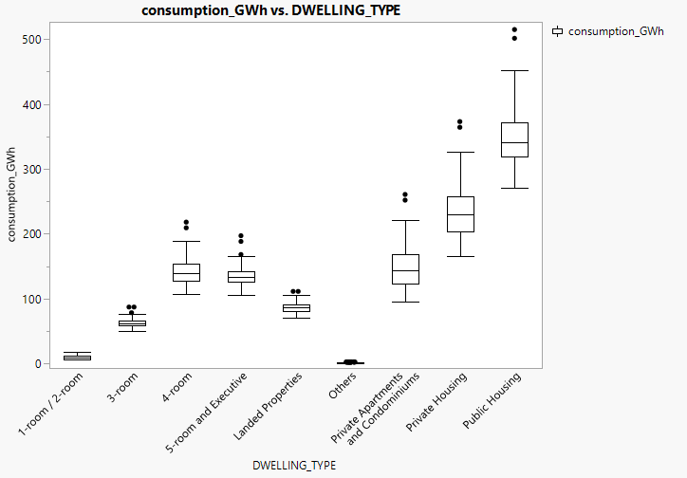
Monthly consumption per Dwelling Type from 2005-2022

Slide 33
Electricity Consumption over time for each Dwelling Type

Slide 34
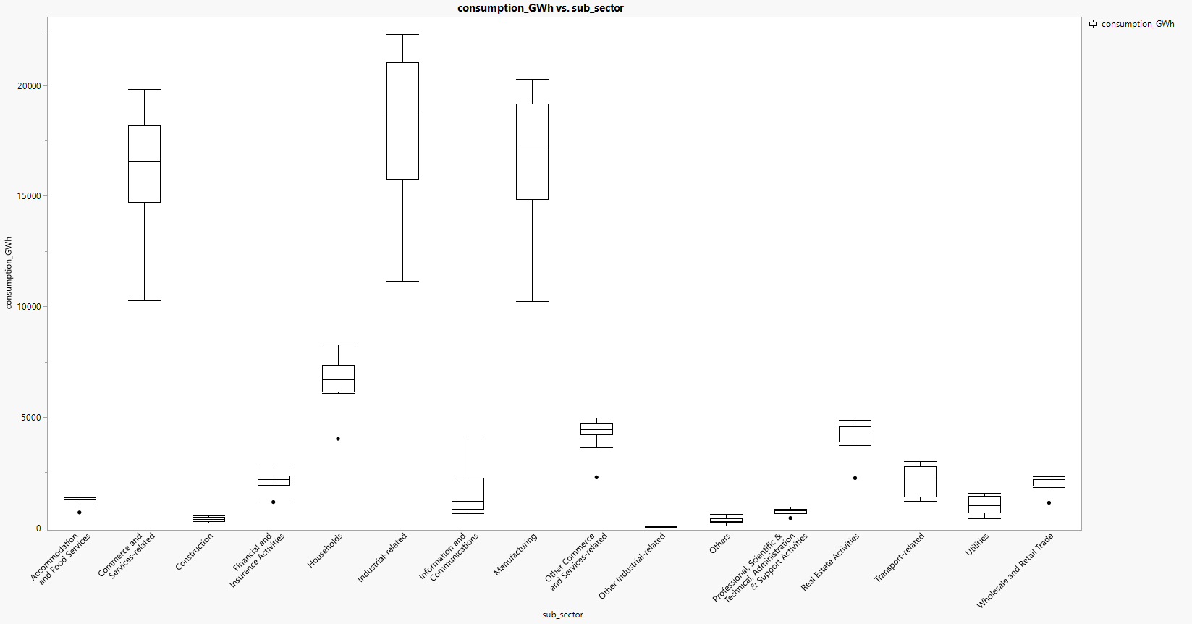
Electricity consumption by Industry from 2005-2022

